Slide 1


CSE 408:DESIGN AND ANALYSIS OF ALGORITHMS
Lecture: 0

Slide 2
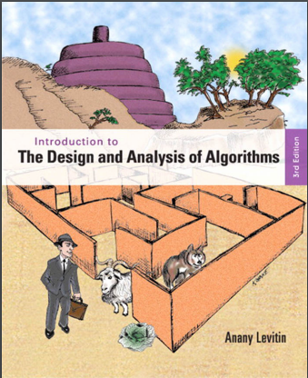
Course Details
LTP – 3 0 0 [Three lectures
/week]
2. Text Book
INTRODUCTION TO THE
DESIGN AND ANALYSIS
OF ALGORITHM
by ANANY LEVITIN,PEARSON

Slide 3
Marks Breakup:
* 2 Best CA out of 3 CA (Class test, MCQ).
CA1 (Class Test) will be held on 4th Week
CA2 (Class Test) Will be held on 7th Week
CA3 (Class Test) Will be held on 11th Week
Activity | Marks
Attendance | 5
Continuous Assessment (CA)* | 25
Mid-Term Examination (MTE) | 20
End-Term Examination (ETE) | 50
Total | 100

Slide 4
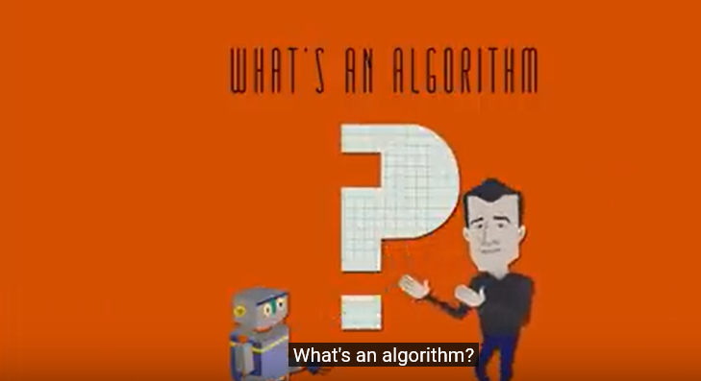

Slide 5


Slide 6
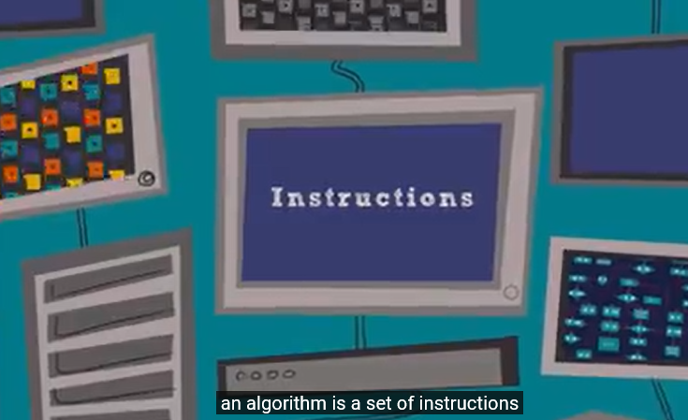

Slide 7


Slide 8
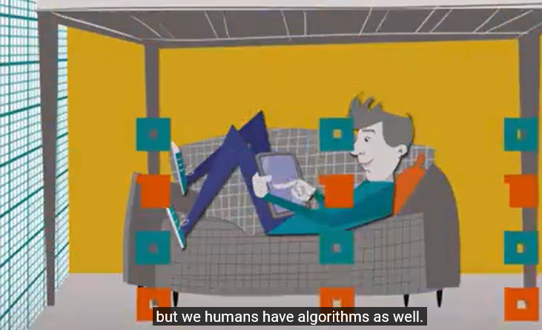

Slide 9


Slide 10


Slide 11


Slide 12


Slide 13


Slide 14


Slide 15
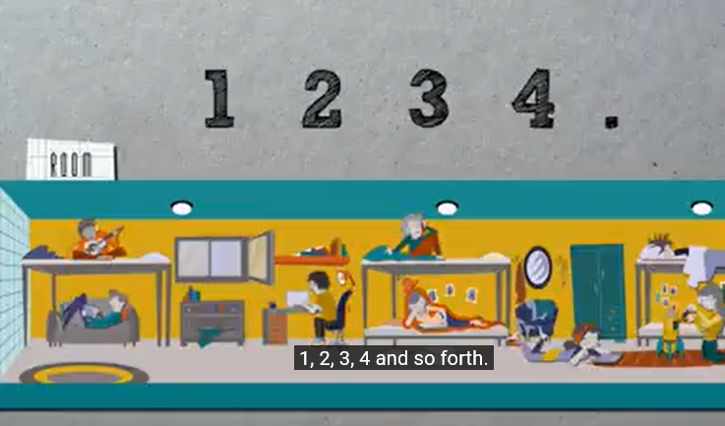

Slide 16


Slide 17
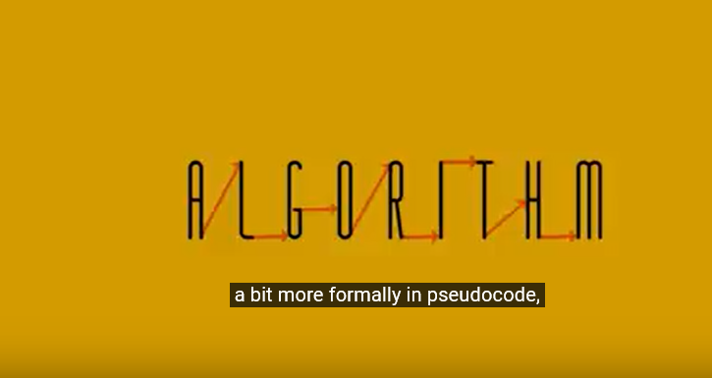

Slide 18
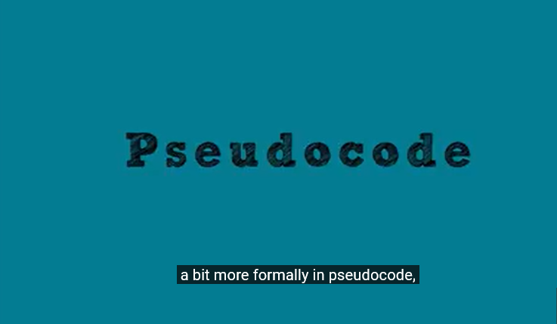

Slide 19


Slide 20


Slide 21
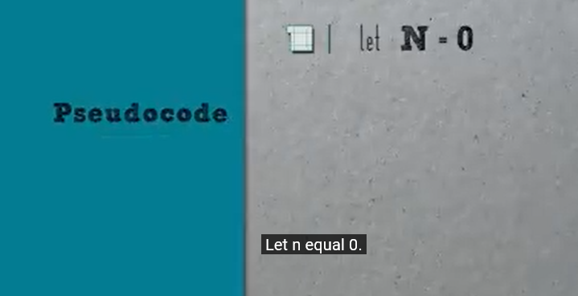

Slide 22
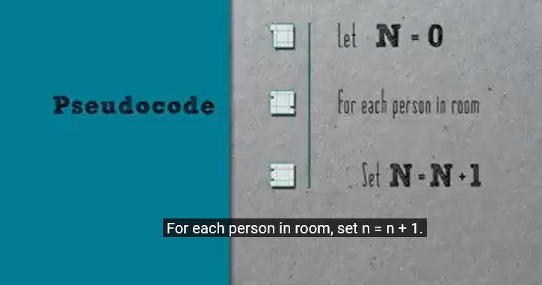

Slide 23
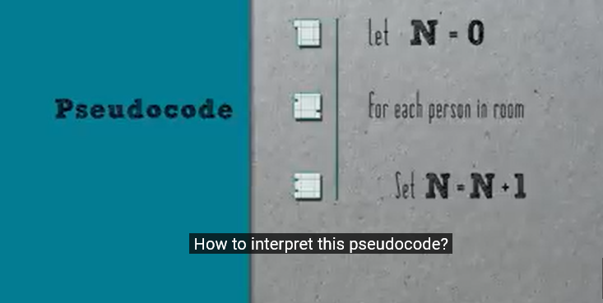

Slide 24
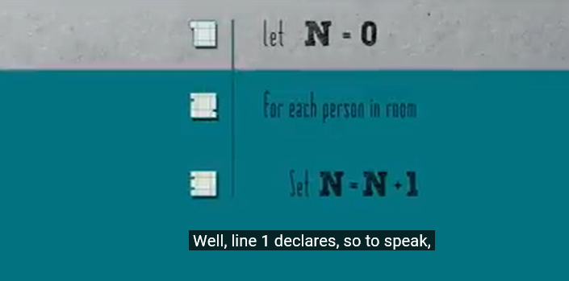

Slide 25
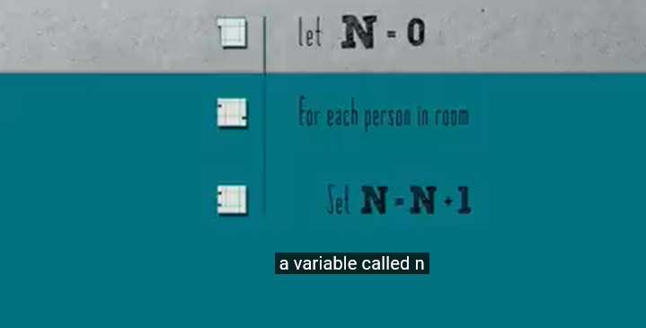

Slide 26
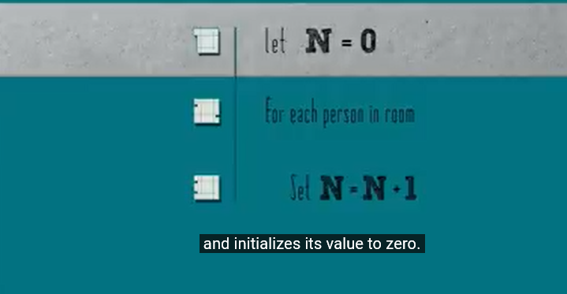

Slide 27
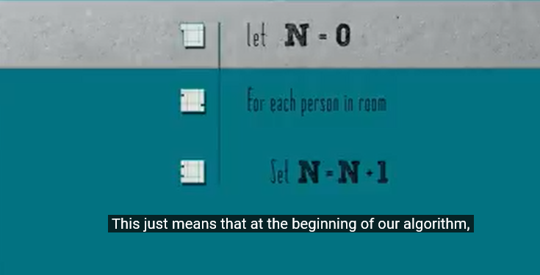

Slide 28
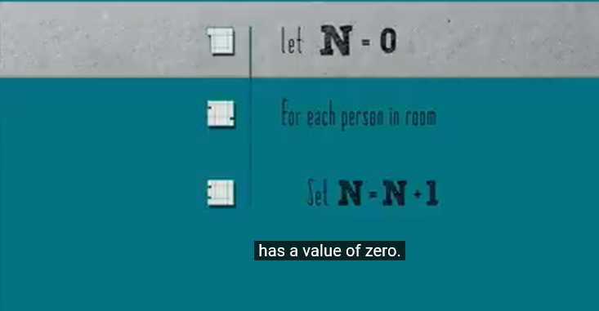

Slide 29
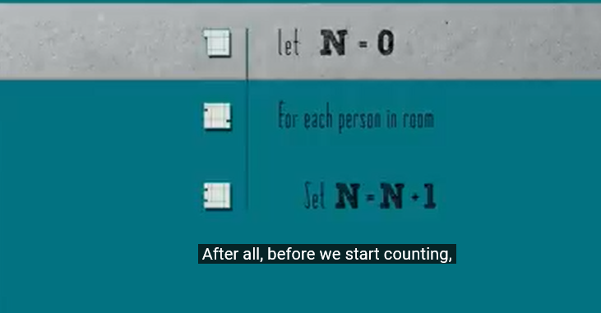

Slide 30


Slide 31


Slide 32
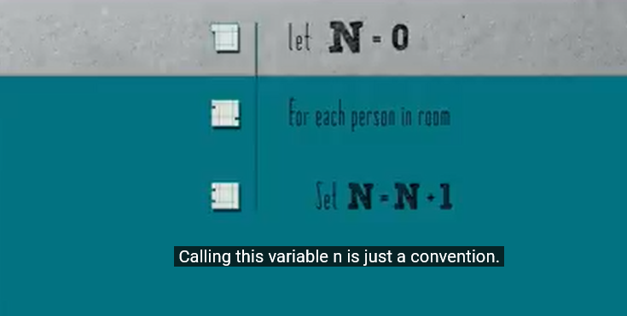

Slide 33
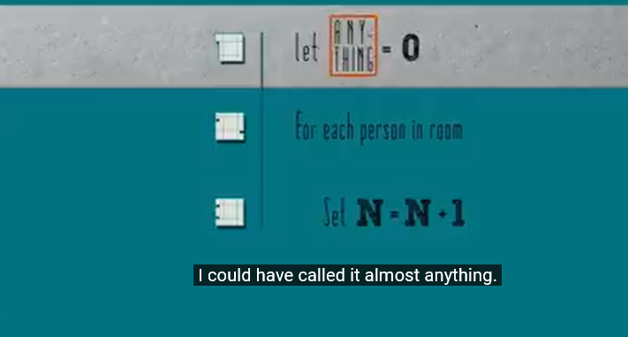

Slide 34
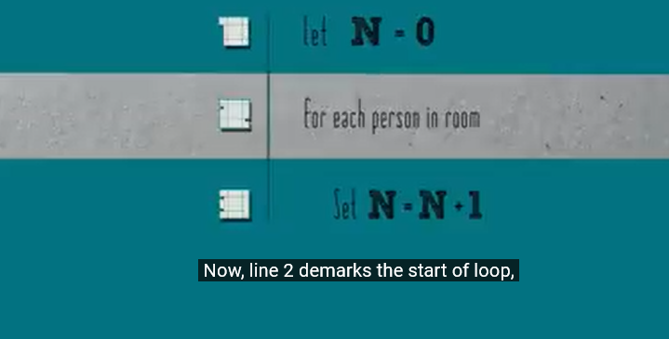

Slide 35
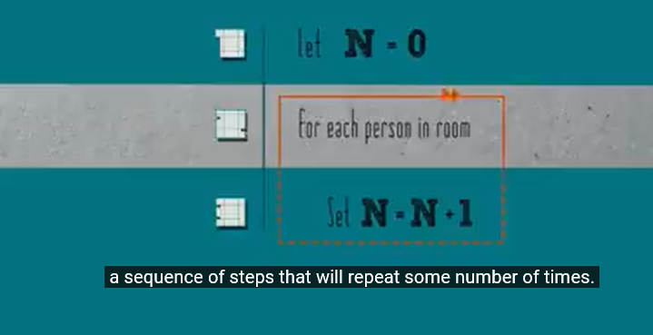

Slide 36
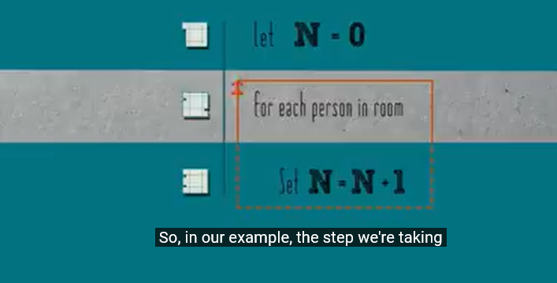

Slide 37
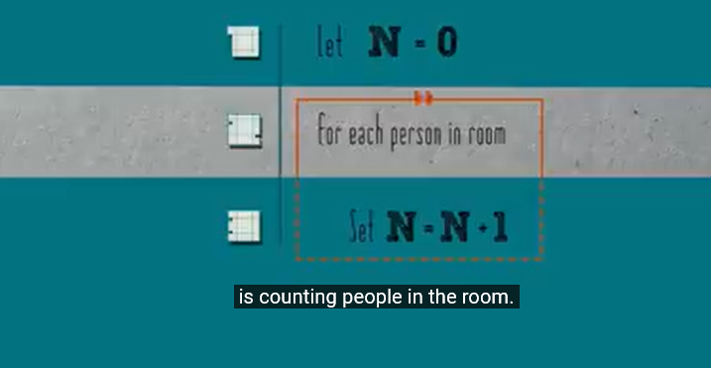

Slide 38
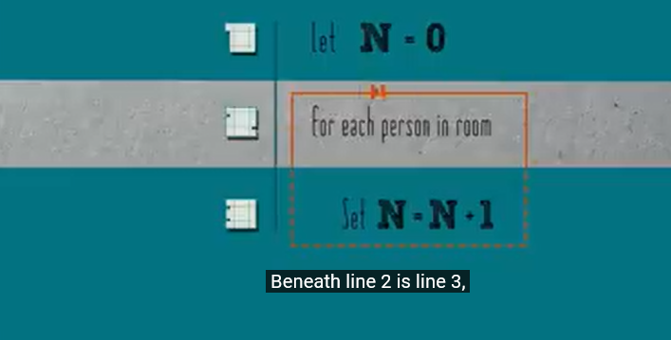

Slide 39
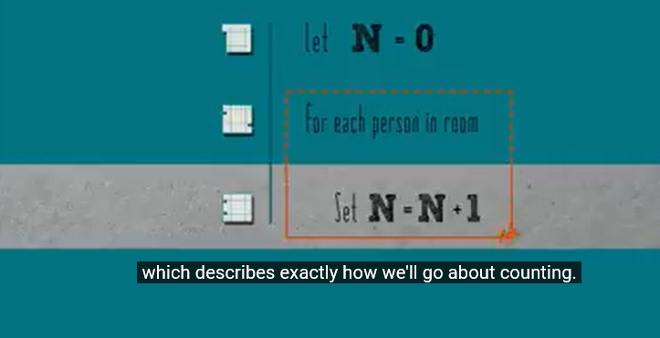

Slide 40
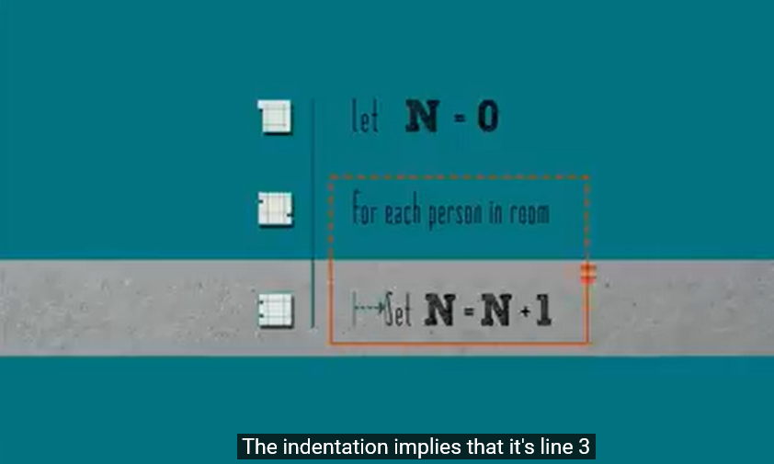

Slide 41
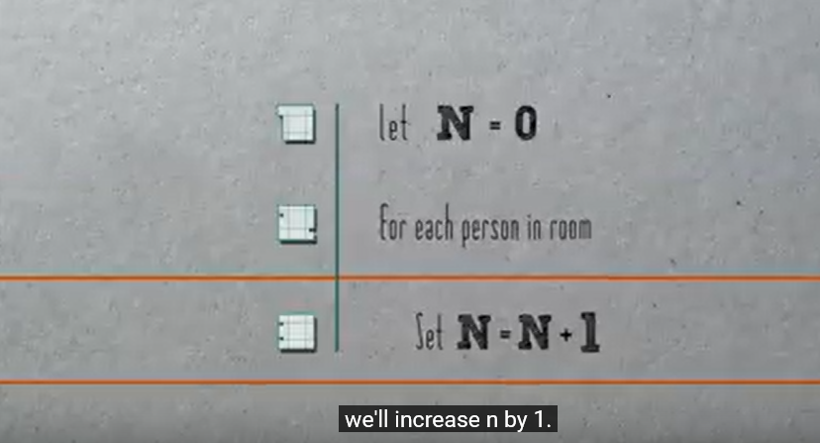

Slide 42
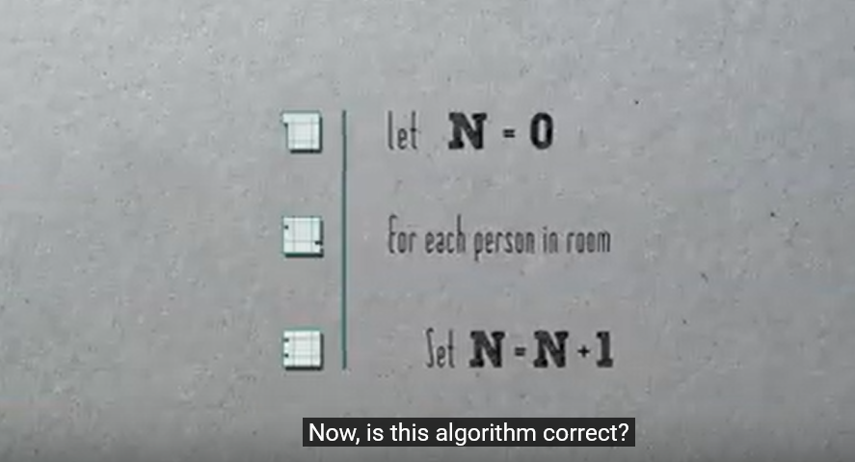

Slide 43


Slide 44


Slide 45


Slide 46
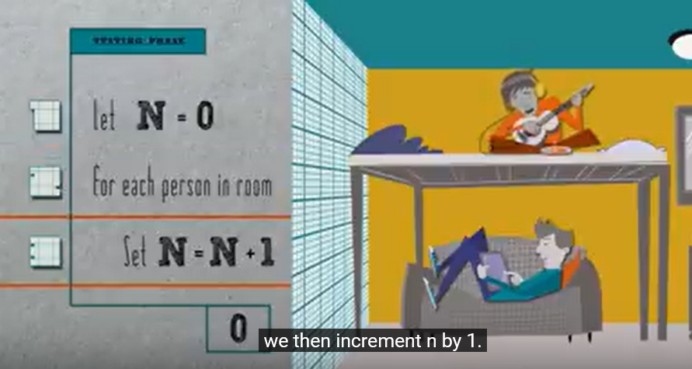

Slide 47


Slide 48


Slide 49


Slide 50


Slide 51


Slide 52


Slide 53


Slide 54


Slide 55
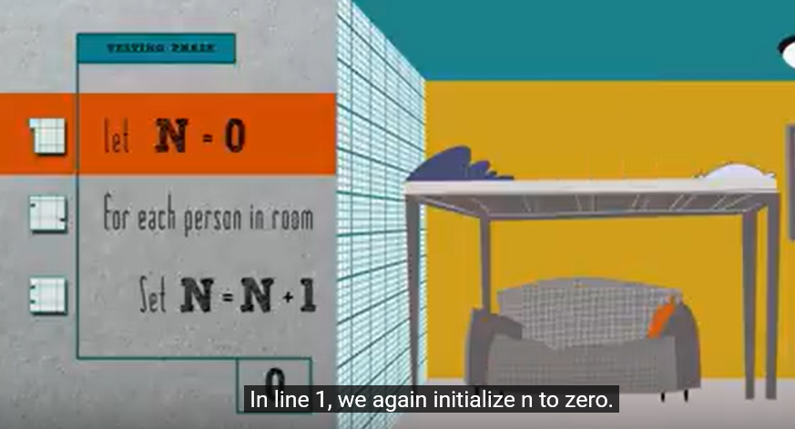

Slide 56
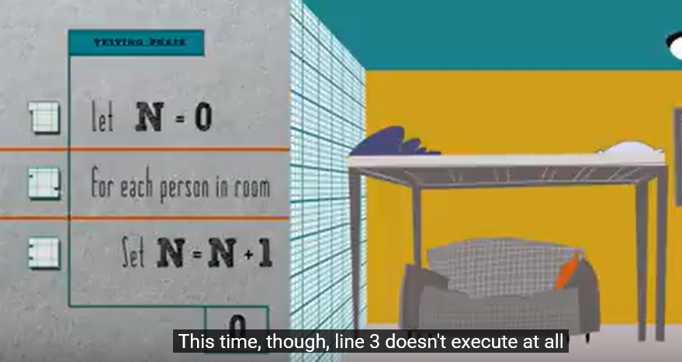

Slide 57


Slide 58
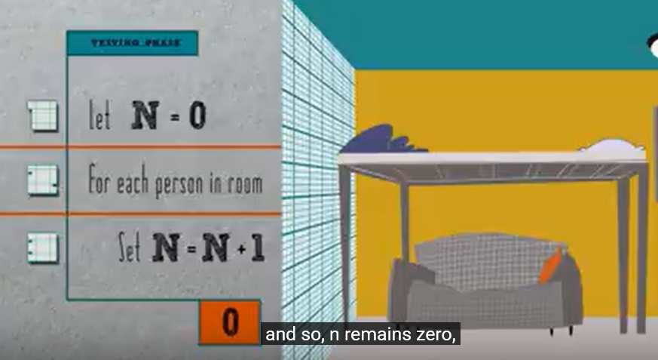

Slide 59


Slide 60
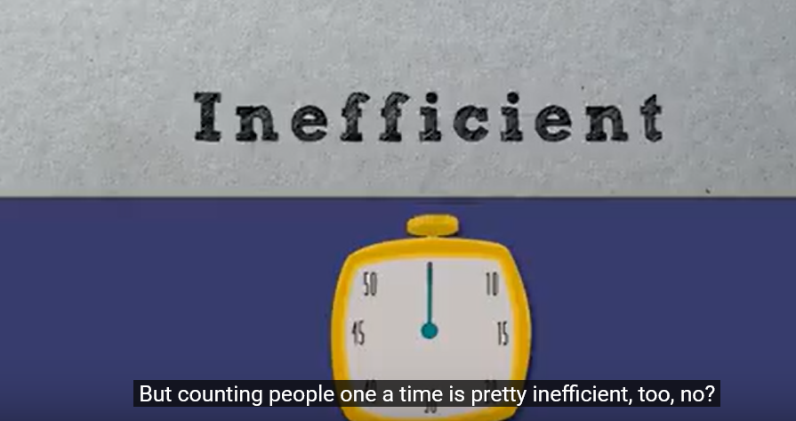

Slide 61
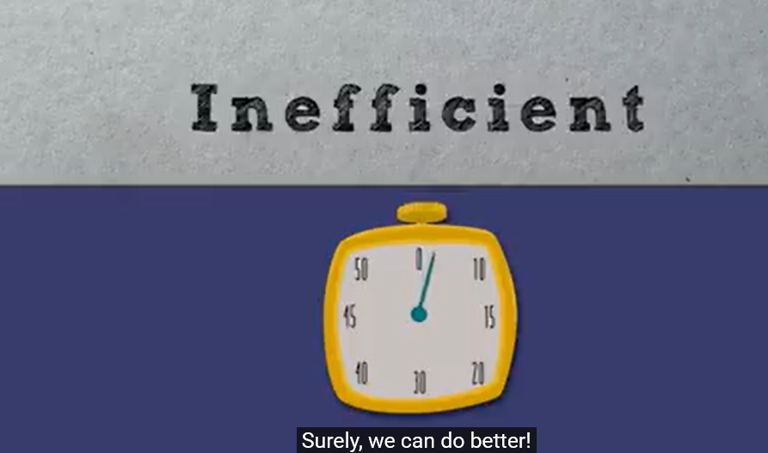

Slide 62
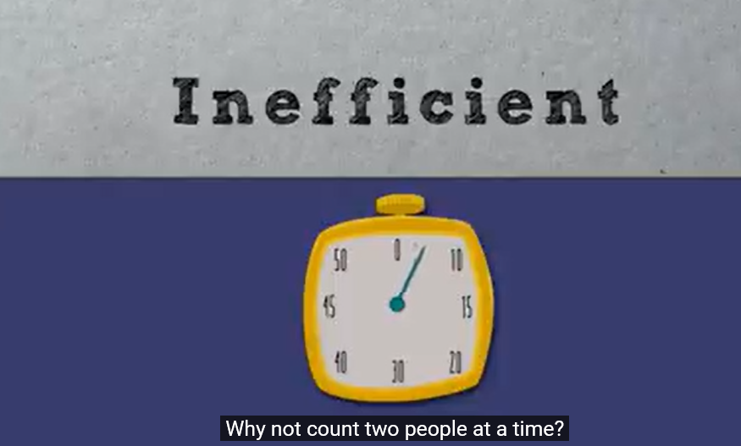

Slide 63
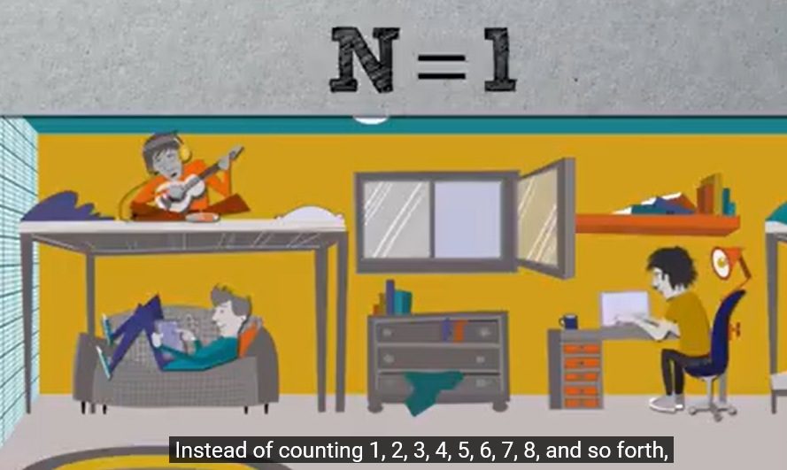

Slide 64


Slide 65
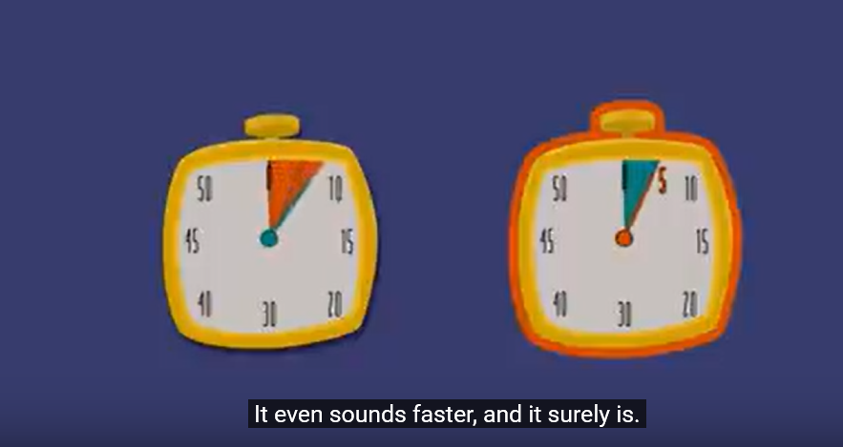

Slide 66
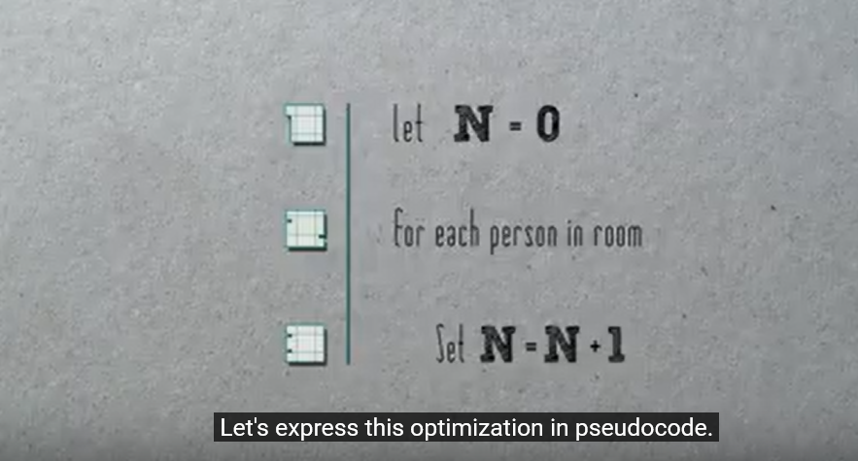

Slide 67
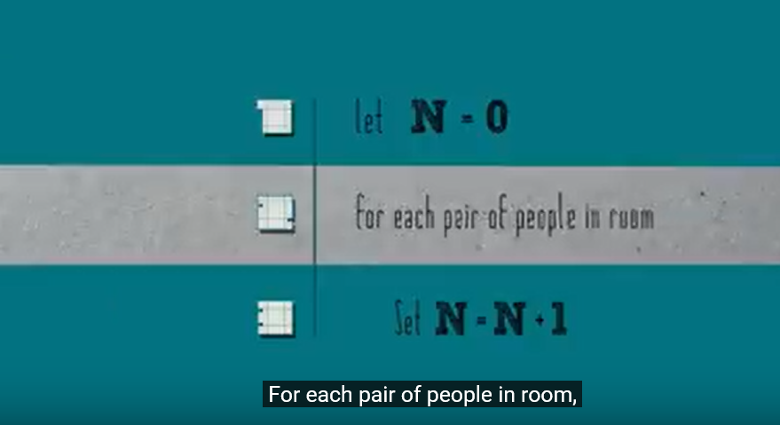

Slide 68
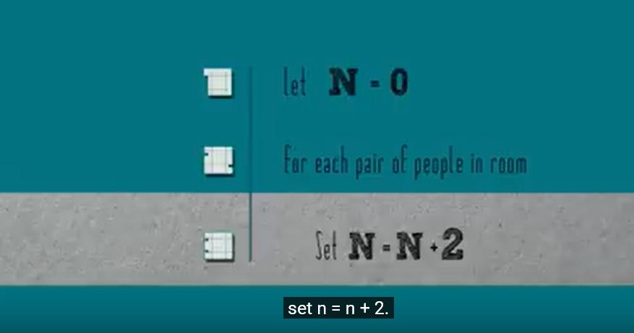

Slide 69
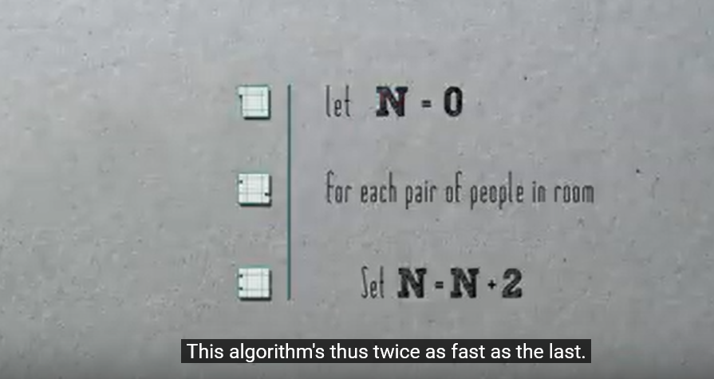

Slide 70


Slide 71


Slide 72


Slide 73


Slide 74


Slide 75


Slide 76
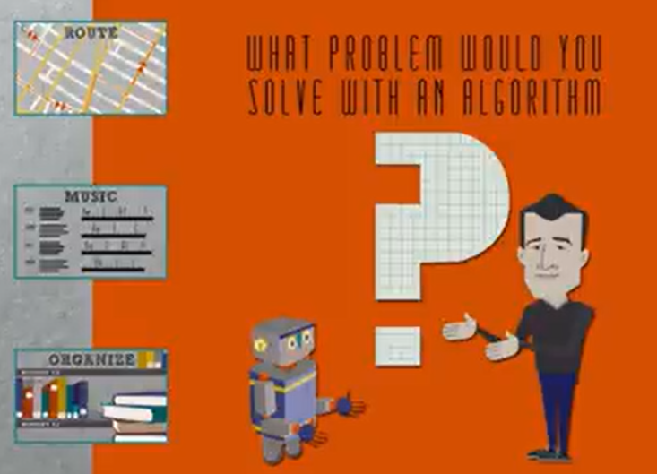

Slide 77
Algorithms

Slide 78
Course Outcomes :
CO1 :: explain the basic techniques of analyzing the algorithms using space and time complexity, asymptotic notations
CO2 :: analyse various string matching algorithms and understand brute force algorithm design technique
CO3 :: understand divide and conquer algorithm design technique using various searching and sorting algorithms
CO4 :: define dynamic programming and greedy algorithm design technique and solve various all pair and single source shortest path problems
CO5 :: apply the backtracking method to solve some classic problems and understand branch and bound algorithm design technique
CO6 :: define various number theory problems and understand the basics concepts of complexity classes

Slide 79
Introduction
The methods of algorithm design form one of the core practical technologies of computer science.
The main aim of this lecture is to familiarize the student with the framework we shall use through the course about the design and analysis of algoriTHM

Slide 80
Algorithms
The word algorithm comes from the name of a Persian mathematician Abu Ja’far Mohammed ibn-i Musa al Khowarizmi.
In computer science, this word refers to a special method useable by a computer for solution of a problem. The statement of the problem specifies in general terms the desired input/output relationship.
For example, sorting a given sequence of numbers- insertion sort

Slide 81
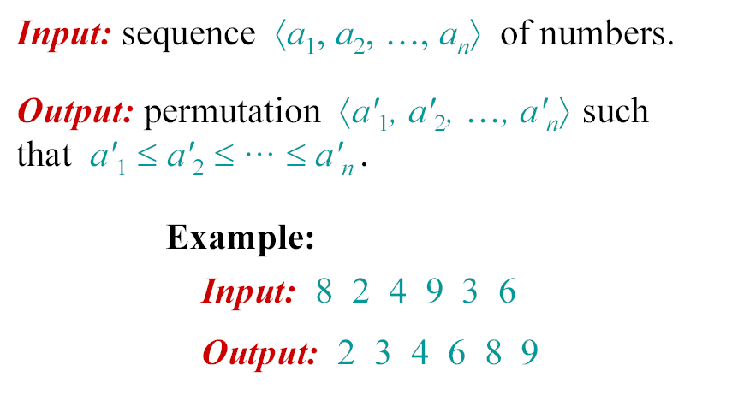
The problem of sorting

Slide 82

Example of Insertion Sort

Slide 83
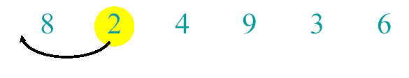
Example of Insertion Sort

Slide 84
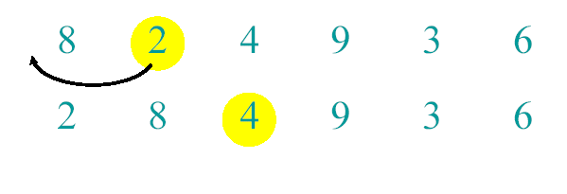
Example of Insertion Sort

Slide 85
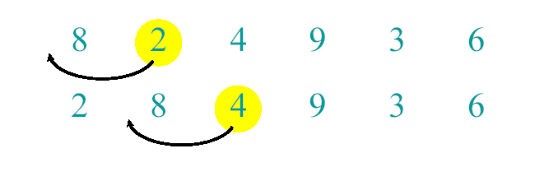
Example of Insertion Sort

Slide 86
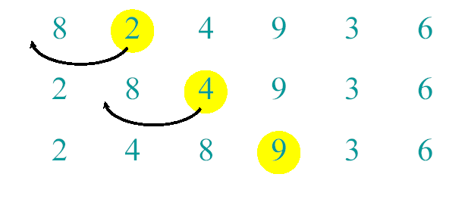
Example of Insertion Sort

Slide 87
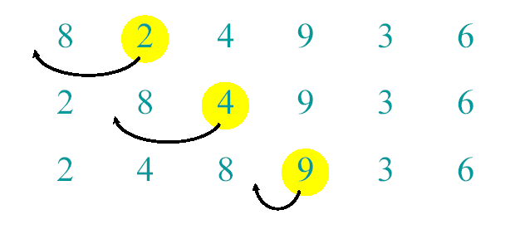
Example of Insertion Sort

Slide 88
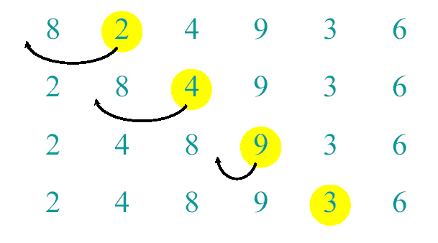
Example of Insertion Sort

Slide 89
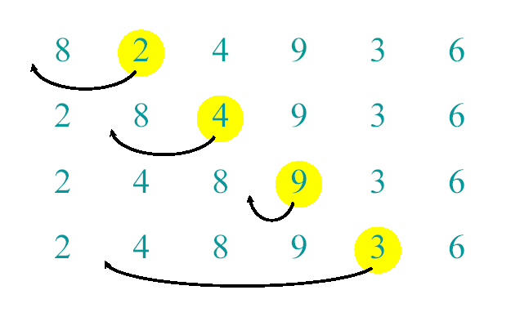
Example of Insertion Sort

Slide 90
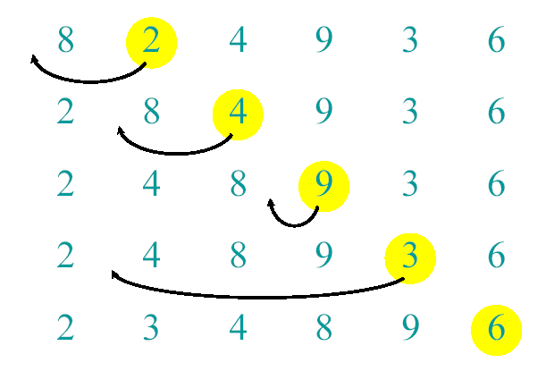
Example of Insertion Sort

Slide 91

Example of Insertion Sort

Slide 92

Example of Insertion Sort

Slide 93
Machine-independent time: An example
A pseudocode for insertion sort ( INSERTION SORT ).
INSERTION-SORT(A)
for j ← 2 to length [A]
key ← A[ j]
i ← j – 1
while i > 0 and A[i] > key
A[i+1] ← A[i]
i ← i – 1
A[i +1] ← key

Slide 94
Analysis of algorithms
The theoretical study of computer-program
performance and resource usage.
What’s more important than performance?
• correctness
• maintainability
• user-friendliness
• programmer time
• simplicity

Slide 95
Analysis of algorithms
Why study algorithms and performance?
• Algorithms help us to understand scalability.
• Performance often draws the line between what is feasible and what is impossible.
• Speed is fun!

Slide 96
Running Time
• The running time depends on the input: an already sorted sequence is easier to sort.
• Parameterize the running time by the size of the input, since short sequences are easier to sort than long ones.

Slide 97
Kinds of analyses
Worst-case: (usually)
• T(n) = maximum time of algorithm on any input of size n.
Average-case: (sometimes)
• T(n) = expected time of algorithm over all inputs of size n.
• Need assumption of statistical distribution of inputs.
Best-case:
• Cheat with a slow algorithm that works fast on some input.

